Slide 1



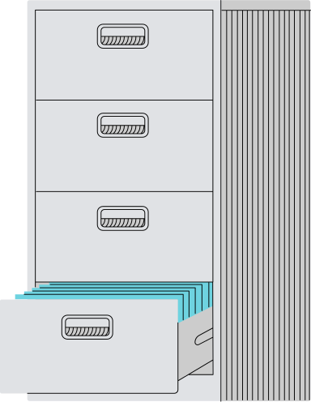


N
Nexazon
Forward Thinking E-Commerce Brand
By:
Srishti Shetty
Gilang Laba
Shreeya Agarwal
Anshika Dixit
Fadly Syahputra
Karen Lin
Sai Dhruv

Slide 2



About the business
N
The chosen business is an e-commerce platform that serves as an online marketplace connecting buyers and sellers. The platform facilitates seamless transactions for a variety of products across multiple categories, ensuring smooth order processing, inventory management, and payment handling.
The database is designed to support essential business functions, including:
Customer and Seller Management: Storing customer and seller details, including contact information, authentication, and order history.
Order Processing: Managing order placement, tracking, and fulfillment while integrating with payment gateways.
Inventory & Supply Chain Management: Keeping real-time stock levels and notifying sellers of low inventory to prevent delays.
Business Analytics & Forecasting: Analyzing sales trends, customer behavior, and product demand to optimize marketing strategies.
Fraud Detection & Quality Control: Identifying suspicious transactions and tracking return rates to detect fraudulent activities.
The platform aims to provide a secure, data-driven, and customer-friendly shopping experience while enabling sellers to expand their business efficiently.

Slide 3
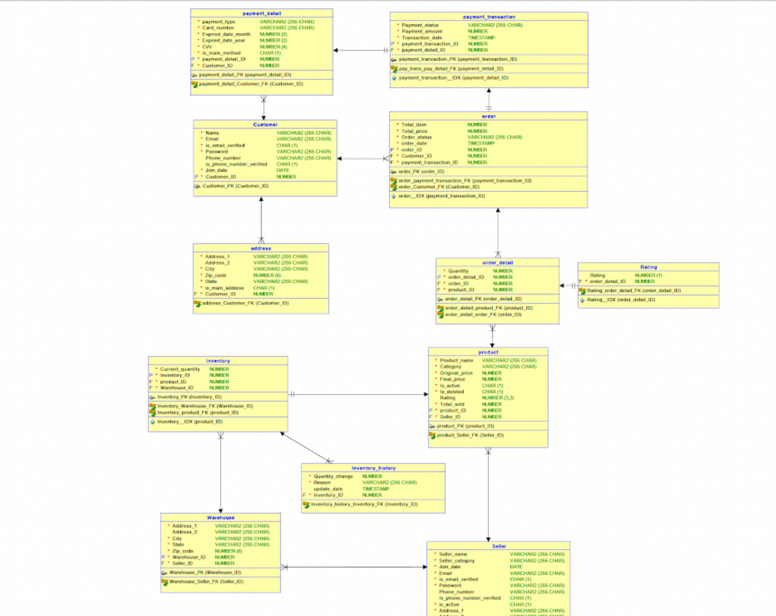
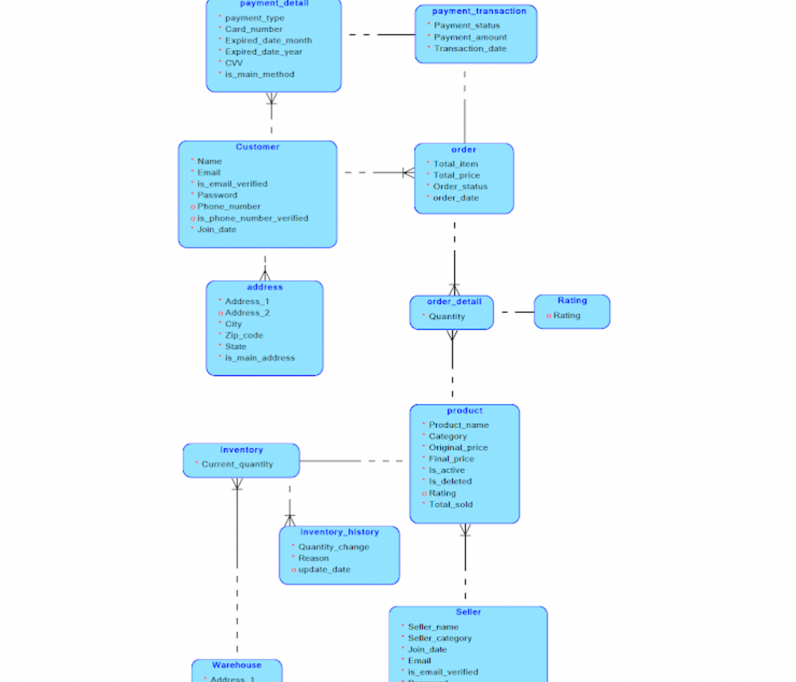
Visual Model

Slide 4
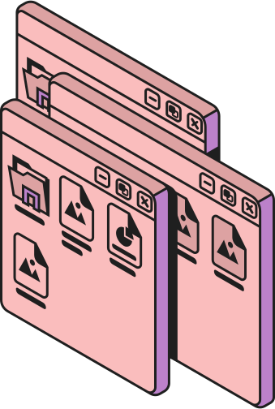
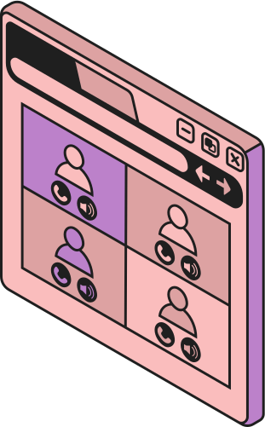
N
DDL
Data Definition Language

Slide 5
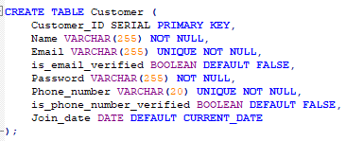
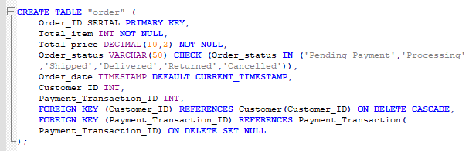
12 Tables:
1
4
7
10
Customer
Order
Rating
Inventory
2
5
8
11
Address
Order Detail
Product
Inventory History
3
6
9
12
Payment Detail
Payment Transaction
Seller
Warehouse
Constraints & Rules
Primary Keys (PK): Ensure each record is uniquely identified.
Foreign Keys (FK): Maintain relationships and data integrity between related tables.
Unique Constraints: Prevent duplicate values, such as emails and phone numbers.
Check Constraints: Validate data (e.g., order_status must be in specific categories).
Default Values: Auto-fill certain fields like join_date and is_email_verified.
Not Null Values: Prevent empty values

Slide 6



DML
Data Modification Language

Slide 7
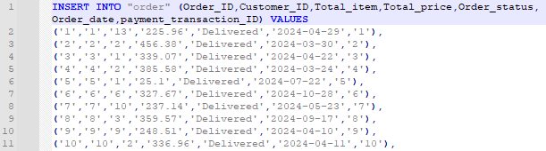
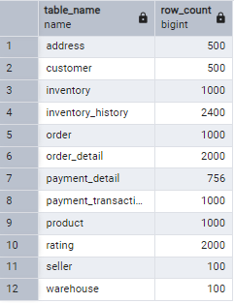
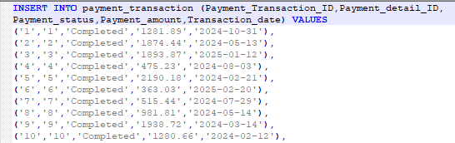
Insert Queries
Row Count
The full insert queries can be found in our GitHub repository

Slide 8
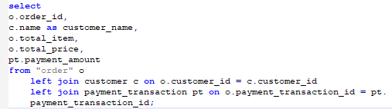
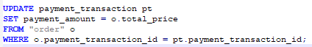
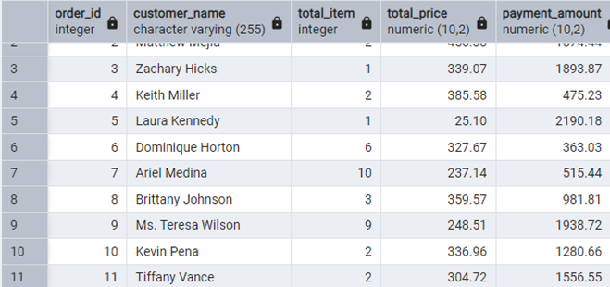
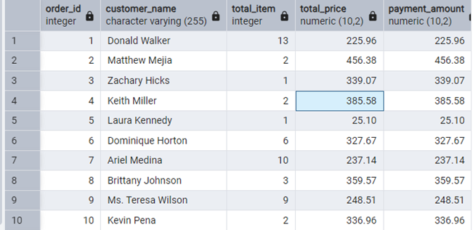
Data Cleansing
1. CLEANSING PAYMENT AMOUNT @ PAYMENT_TRANSACTION TABLE
Before
Updated

Slide 9
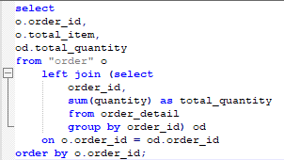
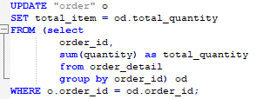
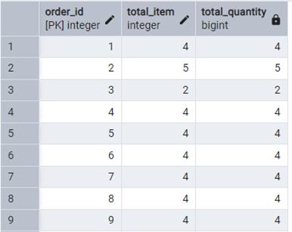
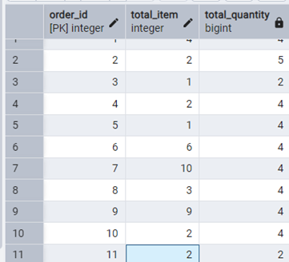
Data Cleansing
2. CLEANSING TOTAL_ITEM @ ORDER TABLE
Before
Updated

Slide 10
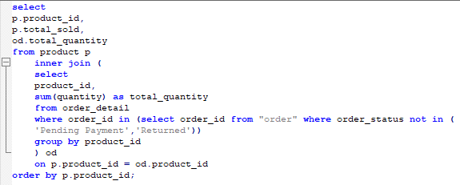
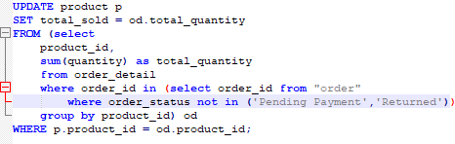
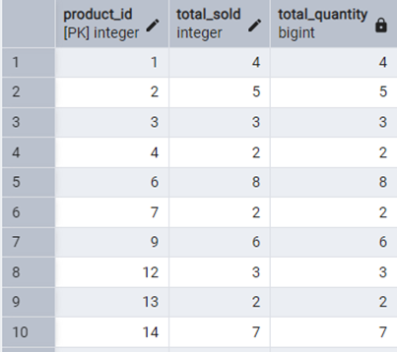
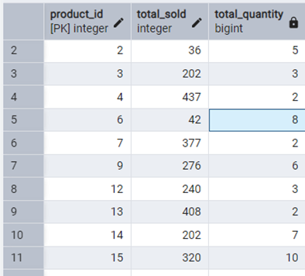
Data Cleansing
3. CLEANSING TOTAL_SOLD @ PRODUCT TABLE
Before
Updated

Slide 11

N
What is the sales trend over time (e.g., daily, weekly, monthly, yearly)?
Purpose: To analyze revenue growth, identify peak sales periods, and plan marketing campaigns or inventory restocking.
Tables Involved:
Order: Contains Order_date and Total_price to calculate sales over time.
Payment_Transaction: Contains Payment_status to filter successful transactions.

Slide 12

Query Strategy
Loaded Order and Payment_transaction in 2 separate sheets.
Used Power query to merge both tables with “Payment_Transaction_ID. Extracted relevant needed columns from merged table.
Used Pivot Table in Excel to aggregate sales over different time frames.
Created Pivot Charts for visualization.
Data Extraction
Data Cleaning & Merging
Data Analysis

Slide 13
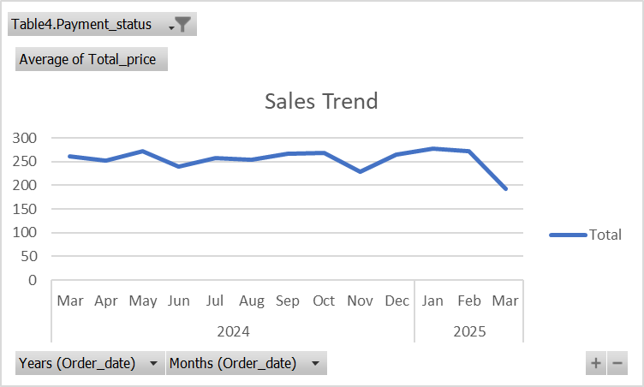
https://1drv.ms/x/c/87ce33f6de1ffc14/ERYWY-3HjT1ElYteufB46hgB2-kxthDRv_mtKrPbN0r89A?e=OSyBCp

Slide 14



N
What is the return rate of products, and what are the common reasons for returns?
The purpose of this is to identify problematic products, improve quality control, and reduce return rates.

Slide 15
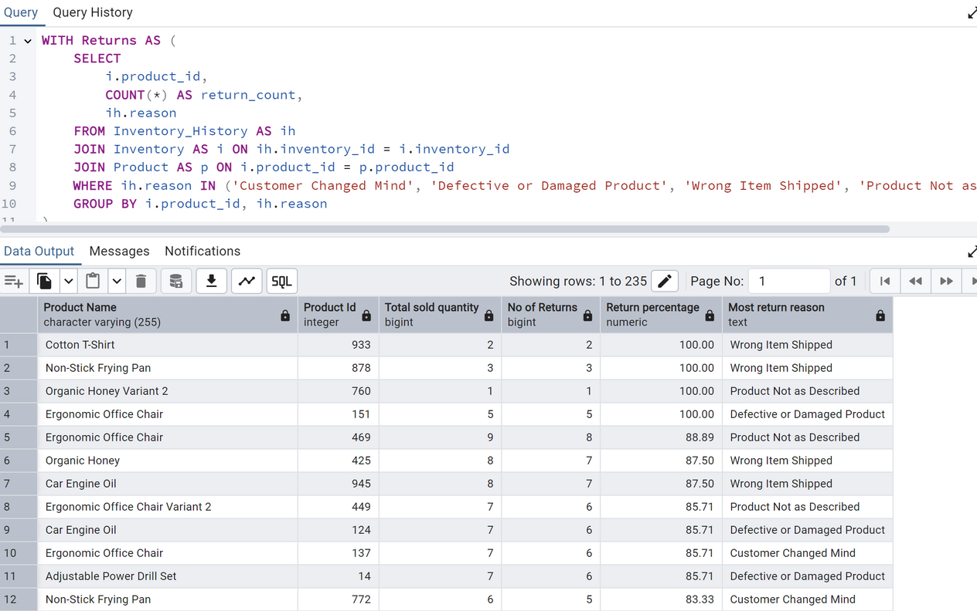

Query Strategy
Identify Returns:
Filter “Inventory_History” for rows where reason indicates a return
Group by “product_id” and “reason” to count returns per product and reason.
Calculate Total Sales:
Join “Order_Detail” with “Order” to filter delivered orders (order_status = 'Delivered').
Group by “product_id” to calculate total sold quantity.
Combine Data:
Join the returns and total sales data with the Product table to get product names.
Return Percentage = (Number of Returns​ / Total Sold Quantity)×100
Filter and Sort:
Filter out products with no returns.
Sort by return percentage in descending order to identify the most problematic products.

Slide 16
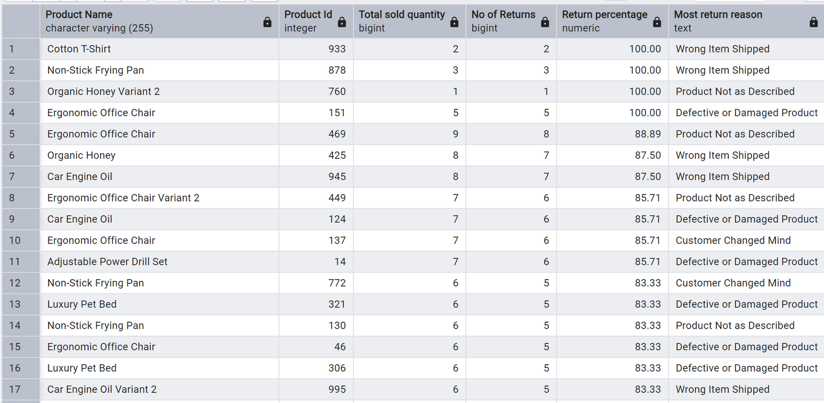






Results & Insights

Slide 17
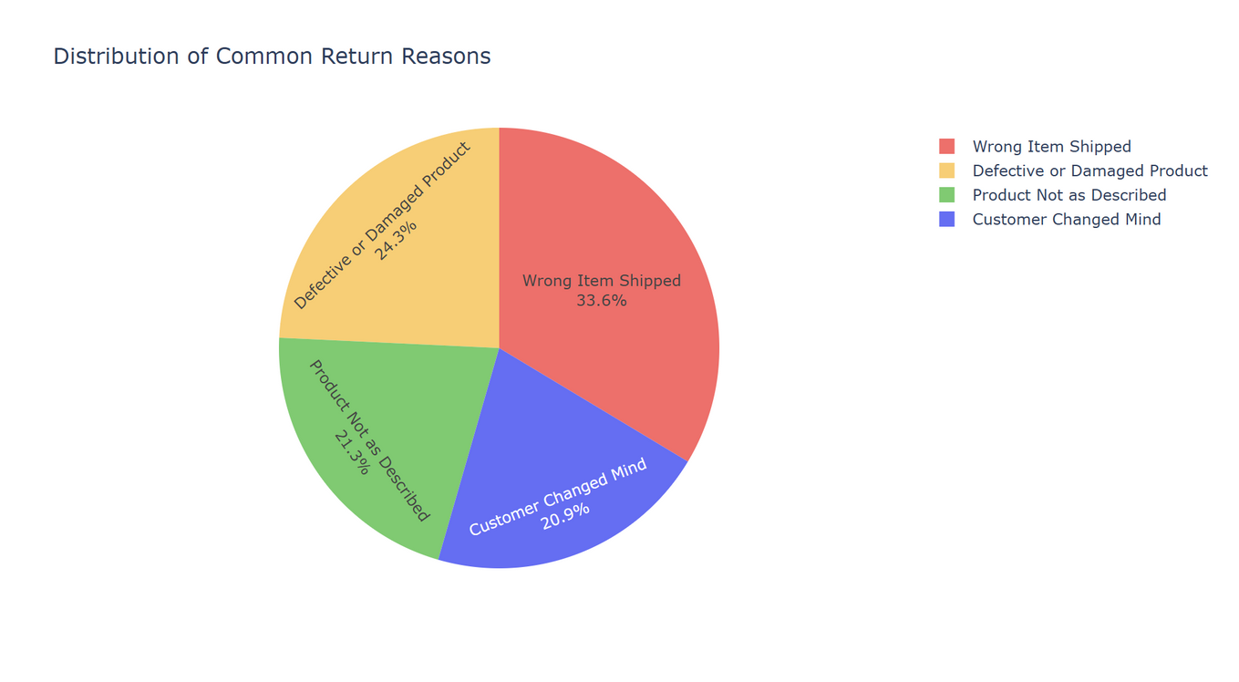


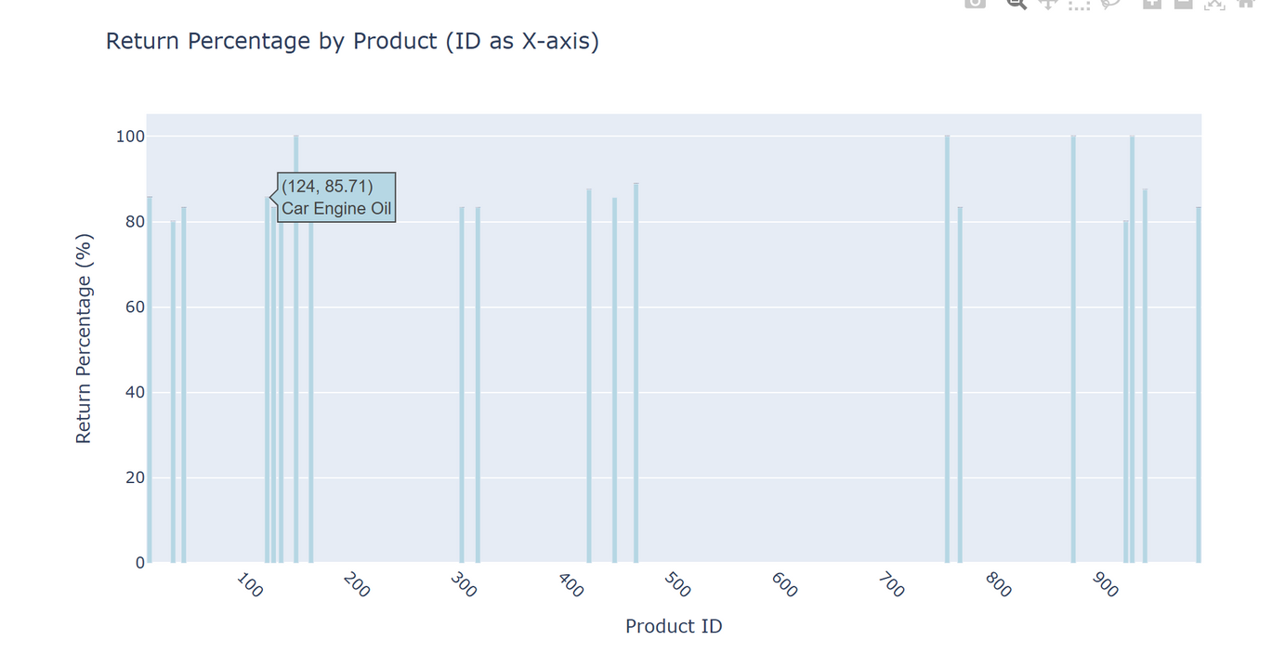
Visualizations

Slide 18
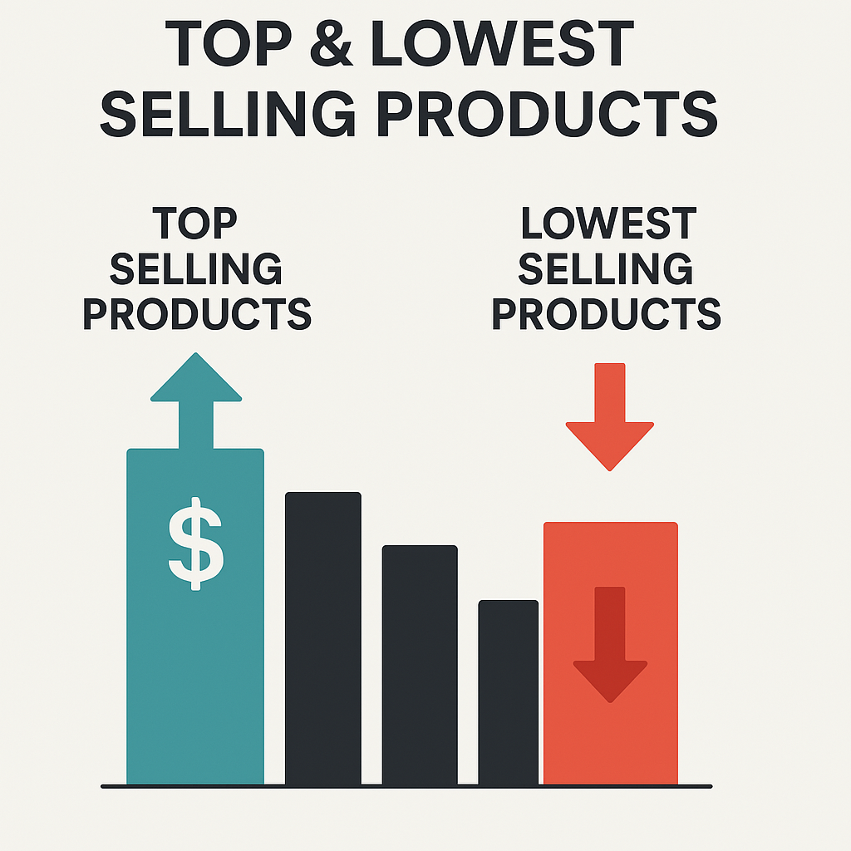
N
Top Selling and High Risk Products
This analysis highlights the top-selling and lowest-selling products, providing insight into customer preferences and areas for potential improvement.

Slide 19
Query Strategy
Top Selling Products
High Risk Products
Identify products with lowest or no sales but high inventory value (inventory*price)
Join Product, Order_Detail, and Inventory tables to combine sales, stock and price data
Filter products total sold =0
Calculate financial risk using [current_quantity]* [final_price]
Order result by inventory value highest to lowest
Identify products with highest sales quantities.
Join product and order_detail to ensure only products with actual sales are considered.
SUM (Quantity) to calculate total quantity sold per product.
Order result by total quantity sold highest to lowest

Slide 20
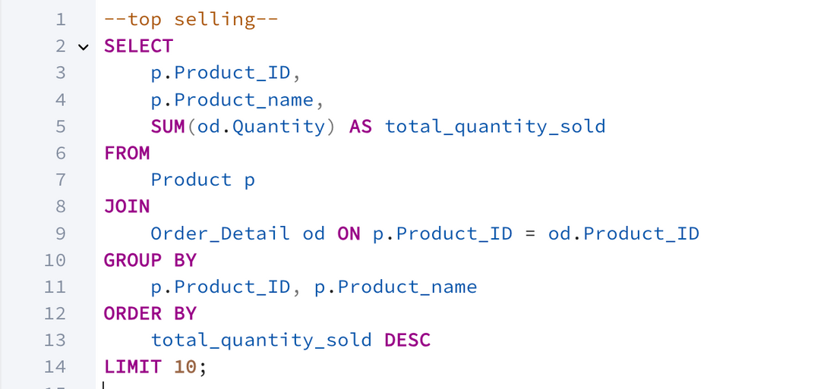
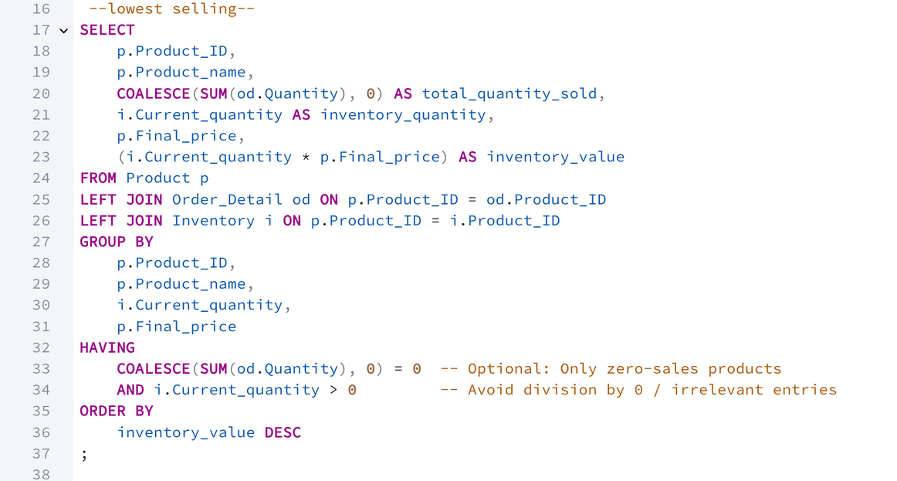
Query Implementation
Top Selling Products
High Risk Products

Slide 21
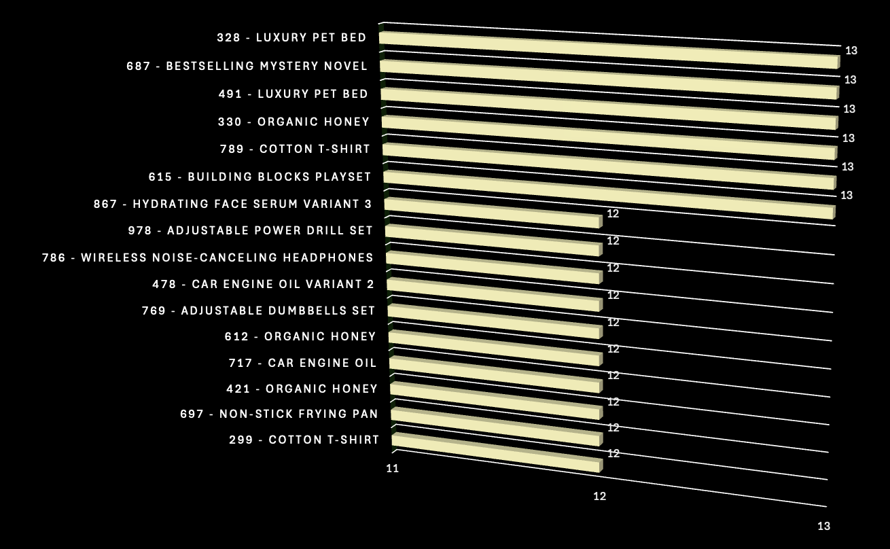
Top 10 Selling Products & Quantity

Slide 22
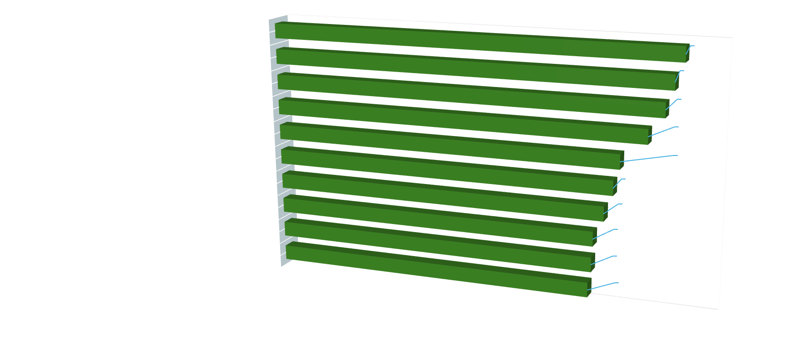
Top 10 High Risk Unsold Products
inventory*final price
Unsold product count: 136
Unsold percentage: 13.6%

Slide 23

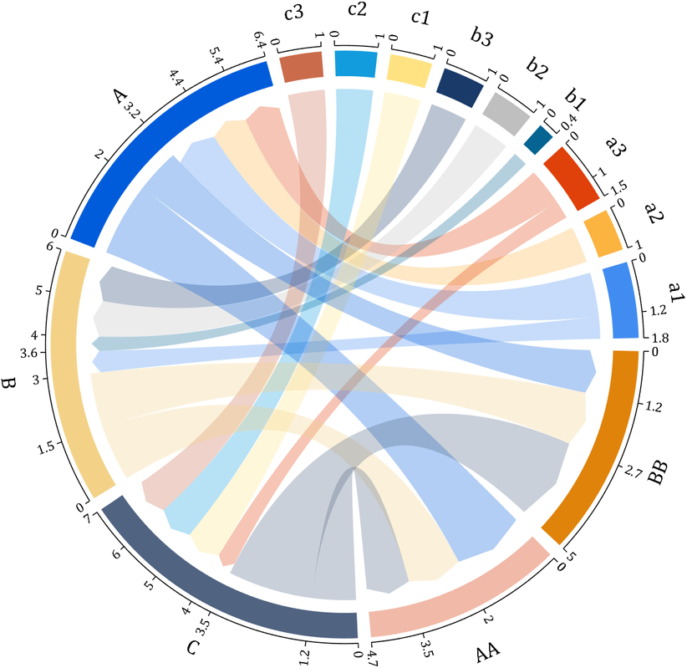
N
What Products are Often Purchased Together?
Market Basket Analysis is useful to increase revenue by cross-selling strategies, bundle promotions, and recommendation systems

Slide 24
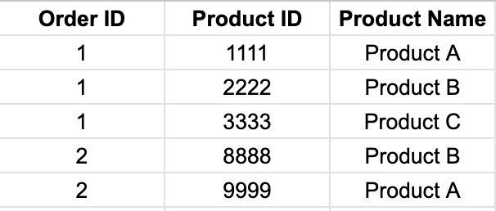
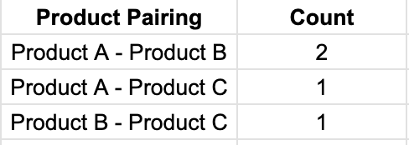
Query Strategy
Transform
Map Products in the Same Order
Utilize Product Name to Group
Count
Use self join
Avoid mapping product to itself
To enable grouping of all products from different sellers
Ensure it’s sorted alphabetically
Group by the pairing name
1
2
3

Slide 25
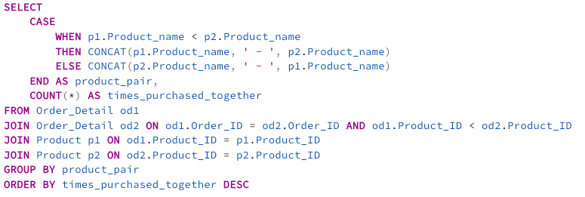
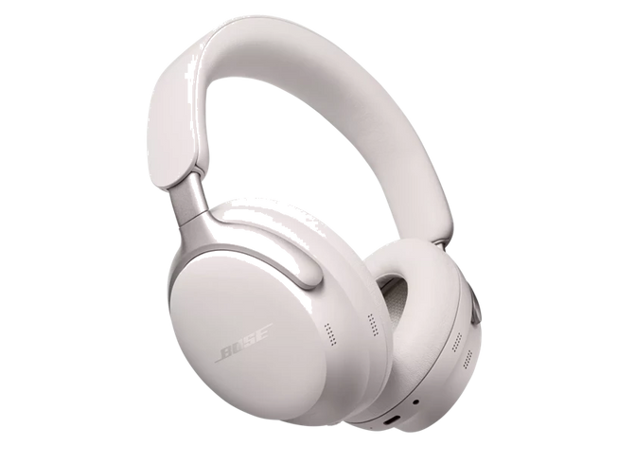

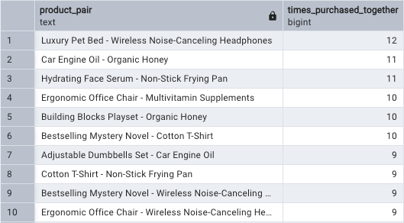
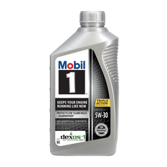
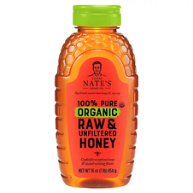
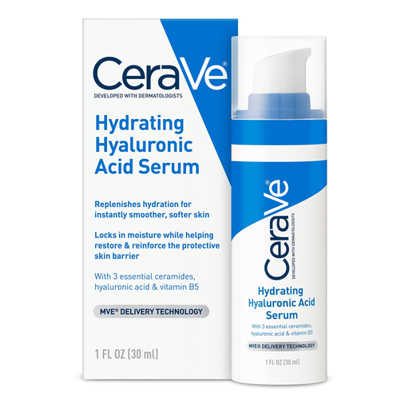
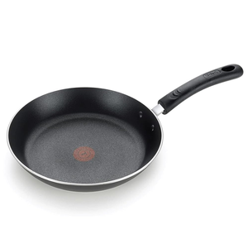
Luxury Pet Bed & Wireless Noise-Canceling Headphones are often purchased together

Slide 26
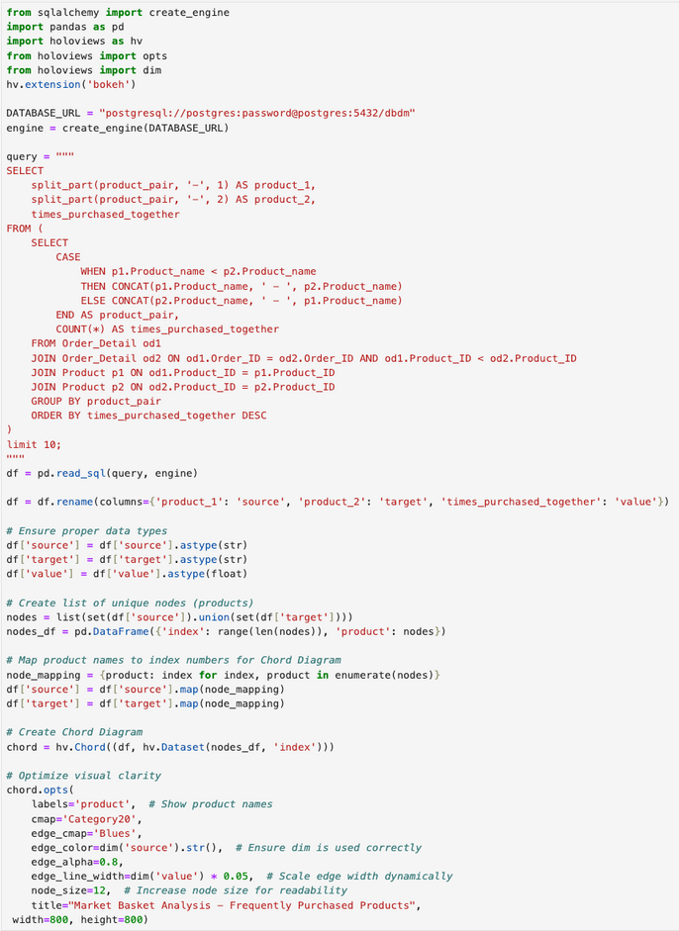
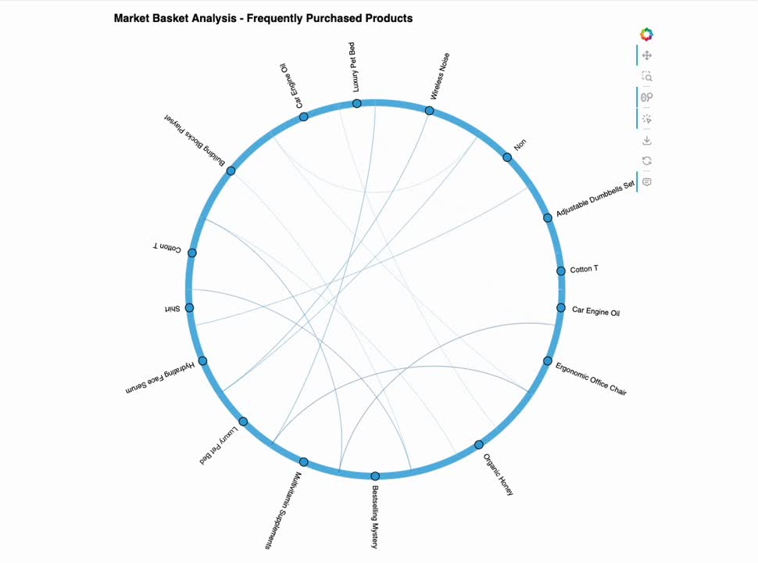

Exploring product purchase relationships in Chord Diagram
using HoloViews library in python

Slide 27
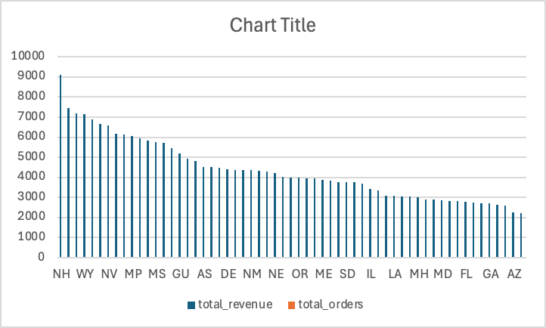
Customer Analysis
Highest region as per purchase: North Carolina , with a total revenue of
9090.65 and the order generated from the state was 36

Slide 28
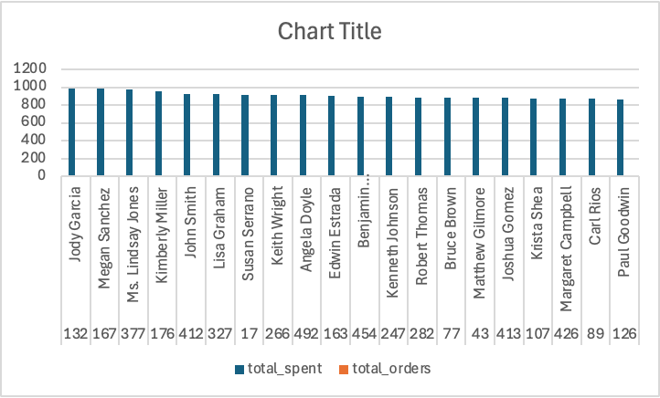
Top Buyers
Average order was 2

Slide 29
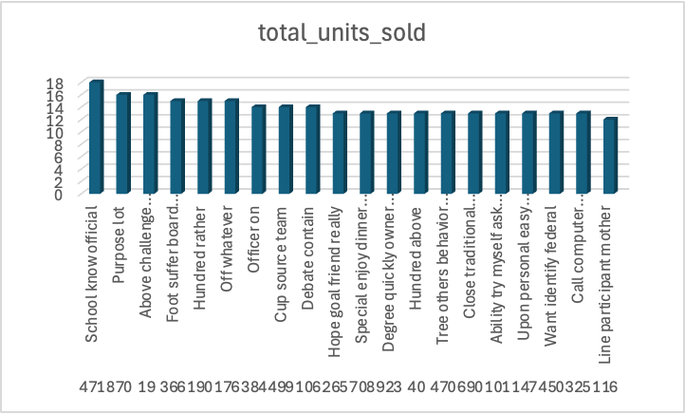
Most purchased products
Most purchased product was School know official, of which 18 units were sold

Slide 30
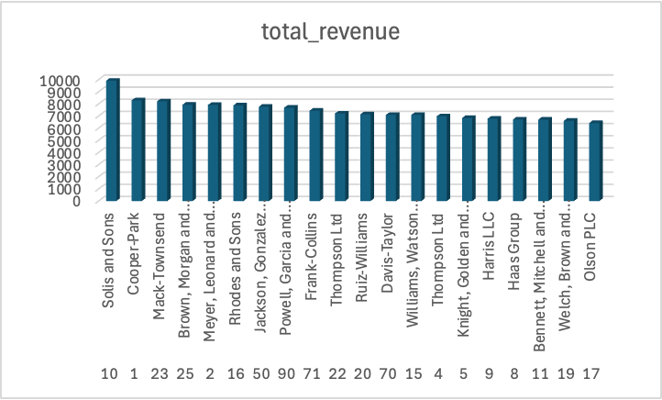
Top seller
The top seller was Solis and Sons with a total revnue of 9907.29

Slide 31
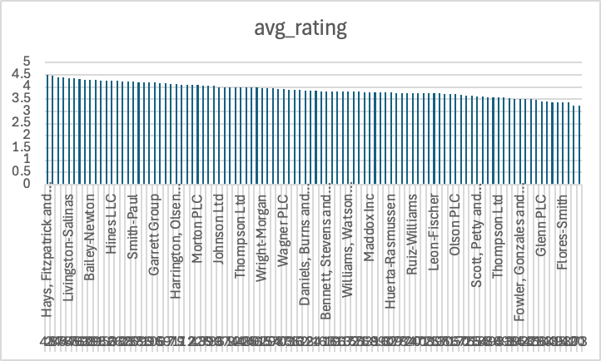
Average rating of sellers

Slide 32




Thank You!
N

